Slide 1

Concerning Death and Resurrection
Our Future Bodies
Week 72
06 December 2023

Slide 2

1 Corinthians Introduction
As we continue our study in First Corinthians, we want to remember that the theme of this letter revolves around Christian Conduct in the local church and how it influences unity, discipline, and spiritual growth …
Again, the primary issue in the church at Corinth was “Progressive Sanctification” – the development of Holy character and the application of Christian principles and discipline on an individual and corporate level. So the corrective in this letter is behavior rather than doctrine.
In our study, Paul provides a theological explanation of the resurrection and the nature of our transformed resurrected bodies. He emphasizes the continuity of life, the diversity of God's creation, and the hope of every believer being conformed to the image of Christ in the resurrection.

Slide 3
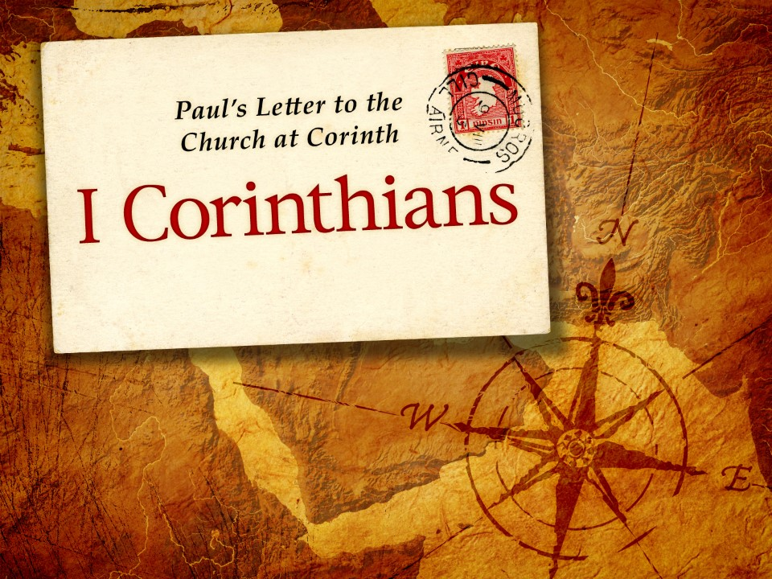
Our Future Bodies
15:35-49

Slide 4
1 Corinthians - Lesson Overview
Swindoll opens our lesson by reminding us that . . . The biblical teaching concerning the resurrection of our bodies is one of those issues with more ellipses than periods, more question marks than exclamation points.
For example, what about infants, will they be resurrected as babies or adults? What happens to the bodies of those who have been cremated, dismembered, or lost at sea?
If we let it happen, the chain of questions can go on endlessly. Most of our questions stem from a lack of knowledge about the biblical doctrine of resurrection.
Scripture lays before us in simple yet profound way answers to the most important questions concerning life, death, and the resurrection.

Slide 5
1 Corinthians - Lesson Overview
It doesn’t attempt to respond to all of our “yeah, buts,” our far-fetched hypotheticals, or the speculative conjuring of inquisitive minds.
And Scripture doesn’t go out of its way to satisfy the snide scoffing of a skeptical critic, whose goal is not understanding but ridicule.
Though Scripture does not provide a complete treatise on the resurrection. Paul’s prolonged discourse in verses 15:35-49 does point us to a better understanding of the nature of the resurrection body.
Although his answers don’t give us all the specifics, they do give us general principles about our future bodies and a deeper understanding of the value of our present ones.

Slide 6
1 Corinthians 15:35-41
³⁵But someone will say, “How are the dead raised up? And with what body do they come?” ³⁶Foolish one, what you sow is not made alive unless it dies. ³⁷And what you sow, you do not sow that body that shall be, but mere grain—perhaps wheat or some other grain. ³⁸But God gives it a body as He pleases, and to each seed its own body. ³⁹All flesh is not the same flesh, but there is one kind of flesh of men, another flesh of animals, another of fish, and another of birds. ⁴⁰There are also celestial bodies and terrestrial bodies; but the glory of the celestial is one, and the glory of the terrestrial is another. ⁴¹There is one glory of the sun, another glory of the moon, and another glory of the stars; for one star differs from another star in glory.

Slide 7
1 Corinthians 15:35-41
Some in the church at Corinth had accepted the gospel of Jesus Christ’s death and resurrection, when it came to their own resurrection, their confidence teetered.
After all, Jesus is the unique God-man and we are mere humans. Perhaps, they thought Jesus fit into a completely different category from “mere humans.”
Or maybe they viewed Jesus’ resurrection not as the actual redemption and perfection of His physical body, but as a “rising” of His spirit for the earth to heaven.
Or perhaps they redefined the nature of Christ’s resurrection body to make it far more spiritual than physical.

Slide 8
1 Corinthians 15:35-41
Whatever logic they followed that led them to denying and downplaying the reality of the resurrection of believers, it had gained enough of a following for Paul to address their confusion by answering two nagging questions:
“How are the dead raised? And with what kind of body do they come? (15:35). Paul dismisses the first question with one sharp rebuke: “What a foolish question!” (15:36).
Swindoll says “When it comes to the miracle of the resurrection of the dead, asking how God is able to do something reveals either a lack of understanding of God, or a complete absence of faith in God’s omnipotence.”
God can do whatever he pleases! Jesus clearly taught, “With God all things are possible” (Matt. 19:26; 22:29).

Slide 9
1 Corinthians 15:35-41
The second question may seem to be a little more reasonable, as it deals with an understandable curiosity about the nature of our resurrected bodies.
Though Paul doesn’t give a comprehensive explanation of the resurrection, he does provide sufficient details to put the Corinthians’ questions to rest.
Using analogies and contrast, Paul invites his us to look ahead with faith and hope at our own resurrection bodies.
Paul then sketches, three word pictures using seeds, flesh, and celestial bodies, to illustrate what our future bodies will be like.

Slide 10
1 Corinthians 15:35-41
  Seeds (15:36-38). The first analogy illustrates both the personal continuity as well as the qualitative discontinuity between the corpse that had been buried and the body that will be raised.
Paul confirms that there is a relationship between the two, that is not simply a reconstitution of the dead parts of the decomposed body.
The resurrection is not simply mortal life resuscitated, nor is it a weird scene from the latest zombie movie.
The continuity between the mortal body and the resurrection body, is real, just as the relationship between a seed and the plant that sprouts from the ground is real.

Slide 11
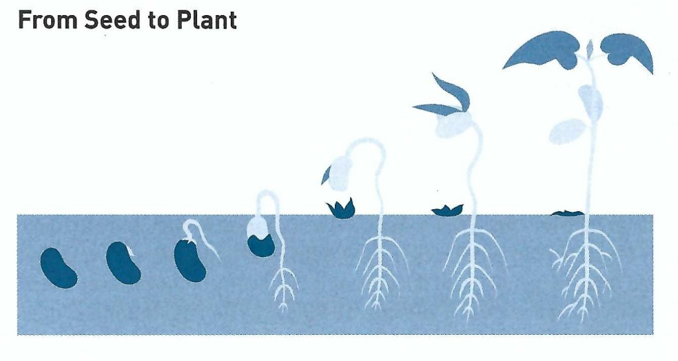
1 Corinthians 15:35-41
The seed vanishes, and is absorbed into the new reality of the plant which looks completely different from the seed.
Between the seed and the plant we observe a clear continuity of species.
So when we plant wheat, we get wheat, not watermelon. When we plant an orange tree, we get oranges not mangoes. The specific identity of the seed determines the identity of the plant.

Slide 12
1 Corinthians 15:35-41
Likewise, between our body that dies and is buried and the body that rises from the grave, we will see continuity of personhood. We will rise from the dead in a form that is distinctly and uniquely us.
The diversity in which God delights will continue to mark resurrected humanity. You will still be you, and I will still be me, but the resurrection will make you a better you, and me a better me.
To understand this continuity, we look to Christ. Yes! the body that was buried on Friday stepped forth from the tomb on Sunday morning – but the mortal had been “swallowed up by life” (2 Cor. 5:4).

Slide 13
1 Corinthians 15:35-41
Was Jesus resurrection body the same as the body that was buried? Yes and No.
It was completely the same in personal identify, but completely different in physical quality.
Jesus rose in His body, not in somebody else’s body. The body that was buried was transformed into the body that was raised, not destroyed or replaced.
Flesh (15:39). Paul second analogy emphasizes the distinctiveness of our future bodies. During creation God carefully marked each species of animal with distinctions all their own.
So, we will continue to bear the distinguishing features of our present bodies for the purpose of identity and diversity.

Slide 14
1 Corinthians 15:35-41
Jesus disciples were able to recognize the resurrected Lord (John 20:19-20). So, that assures us that we will be recognizable to others and also be able to identify our loved ones.
The idea that we will be indefinite, luminous beings has no foundation in Scripture
Just as humans were created in Eden to live in distinct bodies unique to each of us, so in the restoration of Eden, humans will experience perfect community in diversity.
Celestial bodies (15:40-41). In his last analogy, Paul pictures the diversity of our future bodies, noting the differences in glory among heavenly bodies – the sun, the moon, the stars – and the difference between them and earthly bodies.

Slide 15
1 Corinthians 15:35-41
Paul shows by analogy, that our future “heavenly” bodies will be different from our present earthly bodies, as in the same way no two stars shine with the same brightness, so each of us will have a distinct “glory” of our own.
All of us who will one day be glorified in our “heavenly” bodies will experience a quality and condition of life far superior in glory to what we experienced in our earthly bodies.

Slide 16
1 Corinthians 15:42-49
⁴² So also is the resurrection of the dead. The body is sown in corruption, it is raised in incorruption. ⁴³ It is sown in dishonor, it is raised in glory. It is sown in weakness, it is raised in power. ⁴⁴ It is sown a natural body, it is raised a spiritual body. There is a natural body, and there is a spiritual body. ⁴⁵ And so it is written, “The first man Adam became a living being.” The last Adam became a life-giving spirit. ⁴⁶ However, the spiritual is not first, but the natural, and afterward the spiritual. ⁴⁷ The first man was of the earth, made of dust; the second Man is the Lord from heaven. ⁴⁸ As was the man of dust, so also are those who are made of dust; and as is the heavenly Man, so also are those who are heavenly. ⁴⁹ And as we have borne the image of the man of dust, we shall also bear the image of the heavenly Man.

Slide 17
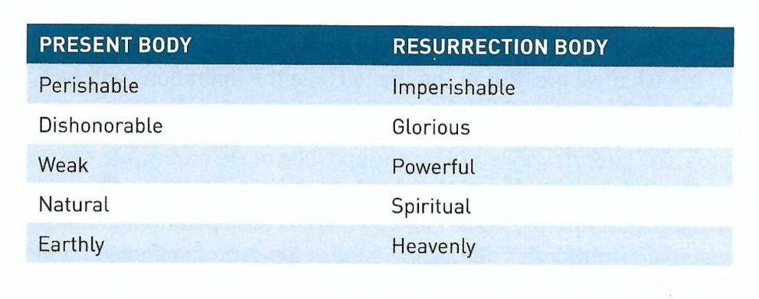
1 Corinthians 15:42-49
Now, having drawn a general picture of our resurrection bodies through everyday analogies, Paul adds some color to his sketch with a series of contracts.
Without denying personal continuity between the body that died and the body that will be raised, Paul emphasizes the qualitative discontinuity between the two (15:42-49).

Slide 18
1 Corinthians 15:42-49
Perishable versus imperishable (15:42). Aging leaves its mark on all of us – dimming our eyes, shutting the doors of our hearing, causing our lips to tremble, turning our spirit of adventure into one of fear (Eccl. 12:1-7).
Slowly but surely our bodies wear down, deteriorate, die. All humans have a “shelf life” that is less than what we wish we had. Yet when we are raised in our new bodies, we will be imperishable.
Instead of winding down, we will be revving up. Instead of deteriorating, we will be thriving. Instead of dying, we will be eternally growing in our ageless relationships with God and others.

Slide 19
1 Corinthians 15:42-49
Dishonorable versus glorious (15:43). Because of their mortal, perishable, and sinful condition, our present bodies can be deemed “dishonorable” compared to the glorious condition of our resurrection bodies.
The Greek word for “dishonor” (atimia), indicates shame or disgrace, which may imply the detestable practices associated with the fallen human condition.
Paul may also have been conveying the condition of the body after death. When it is sown in dishonor, hidden under the earth because of the intolerable stench of death and the unbearable decay that ensues within days.
However, neither moral nor physical dishonor will characterize the resurrection body, only glory and honor.

Slide 20
1 Corinthians 15:42-49
Weak versus powerful (15:43). Though in this life some of us are much stronger than others physically, mentally, and emotionally, all of us have weaknesses.
We are all susceptible to sickness, to injury, to errors of reason, or to moral failures. Faulty, frail and declining in strength – that’s the present human condition.
Yet, these weaknesses will be utterly vanquished by the powerful condition of our resurrection bodies.
Natural versus spiritual (15:44-46). The word translated “natural” is the Greek word “psychikos,” which means “pertaining to being material or physical.” It usually implies a person dominated by the desires of the natural person rather than the promptings of the Spirit (2:14; James 3:15).

Slide 21
1 Corinthians 15:42-49
In this “natural” life, we must constantly restrain the desires of the flesh (Rom. 7:14-25). But in our future resurrected bodies we will not encounter these temptations.
We will be controlled by the power of the Holy Spirit and therefore we will live as Christ lives – in complete holiness and submission to God the Father.
By calling the resurrection body “spiritual,” Paul was not implying that it will be “ghostly” or “immaterial.” Fact is, we will be like Christ physically (1 Jn.3:2), able to do everything He did in His resurrected body (Jn. 20:19-29; Lk. 24:33-43).
Yet, we will be completely free from the weight of earthiness, the gravity of sin, and the downward pull of our fallen condition (Rev.21:4).

Slide 22
1 Corinthians 15:42-49
As further clarification of the natural – spiritual distinction, Paul contrasts the first man, Adam, with the perfect man, Christ (15:44-49).
Adam and Christ had at least two things in common: Their beginning were both unique and sinless. But what they accomplished was altogether different.
Formed from the dust of the ground, the first man, Adam, became a “living soul” when God from heaven breathed into him the “breath of life” (15:45; Gen. 2:7).
The Greek word psyche, translated “soul” shares the same root as psychikos, “natural,” used in 15:44, to describe our present earthly bodies.
Here Paul contrast Adam’s earthly origin as a “soul” with Christ’s heavenly origin as a “spirit” (15:45. 47).

Slide 23
1 Corinthians 15:42-49
Christ, who came from heaven, exists eternally in the same power and glory as the Father (Jn. 1:1-3; 17:5; Phil 2:6).
When Christ took on humanity at the Incarnation, He did not lose His heavenly status, but added full humanity to His fully divine nature (Jn. 1:14; Phil 2:7).
So the eternal Son of God, without diminishing His deity, took on the flesh and soul of humanity, becoming exactly like us in all respects, except for our fallen sin nature (Heb. 4:15).
Having taken on humanity, suffering, and dying as payment for our sin, Christ was raised up to new life. Which involved glorification of the Adamic nature He had assumed – becoming “a life-giving spirit” (15:45).

Slide 24
1 Corinthians 15:42-49
Earthly versus heavenly (15:47-49). Paul’s theologically dense discourse in verses 44-46, leads to his main point regarding the nature of our future resurrection bodies.
As naturally born humans we bear the same physical, earthly nature as Adam, including his sinful disposition (15:48-49).
However, when we are resurrected, we will bear the same spiritual, heavenly nature as Christ. Free from the domain of sin and able to dwell forever with Him in both the heavenly and earthly realms (15:48-49).
The following chart sums up Paul’s contrast between our current “in Adam” condition and our future “in Christ” destination.

Slide 25
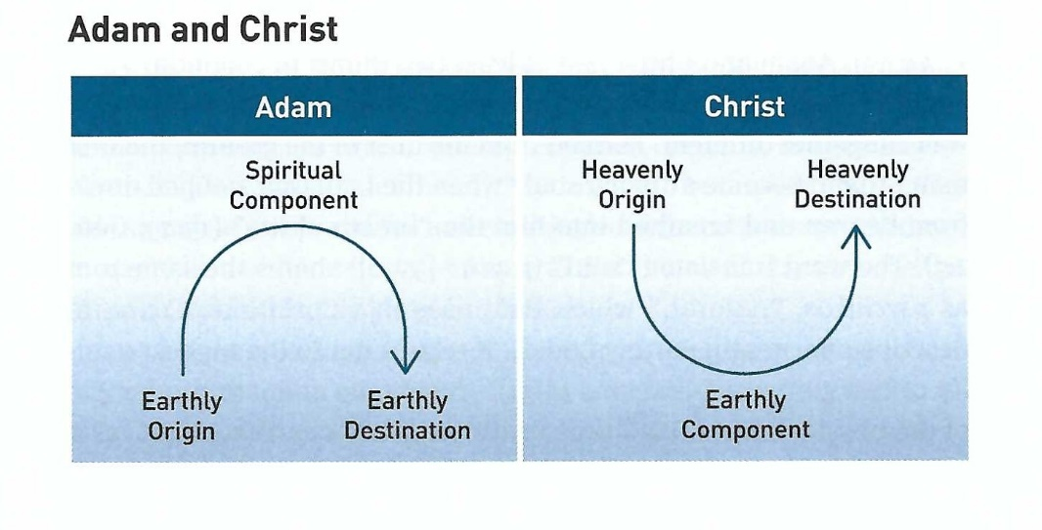
1 Corinthians 15:42-49
Though our bodies were born earthly and destined to perish, this condition is temporary. One day our spirits will be reunited with our bodies.
Which will have been miraculously resurrected, transformed, and glorified – fit for heaven.
Then our bodies will share the heavenly destination of Christ’s resurrected body.

Slide 26
Applications
Of the
lesson
Body Matters

Slide 27
Application – Body matters
In closing Swindoll says … The promise of the resurrection tells us that God has planned a glorious future for His physical creation.
He has placed His seal of approval not on the sin we commit in this world, but on the physical creation itself. God originally created all things “very good” – including humans (Genesis 1:31).
Christ, by becoming truly human, demonstrated that nothing is inherently wrong with the material world or the physical body, for He could be fully divine and fully human – spiritual and physical – without compromising His holiness (John 6:69).

Slide 28
Application – Body matters
So, by resurrecting Christ’s body from the grave, God demonstrates that not only our spiritual aspects but even our physical component is part of His plan of redemption (Rom. 8:23).
God has an interest in His physical creation and especially in our physical bodies. We were never meant to disparage or neglect our physical bodies but to love, respect and care for them, using them to bring glory to God (6:15, 19-20; Rom. 12:1).
Now, in light of this discussion, let’s consider the value of our present bodies – something we all need to be reminded of in a world that tends either to idolize the human physique or to denigrate it as a worthless distraction.

Slide 29
Application – Body matters
That’s why maintaining a healthy, spiritual balance between these extremes can be difficult, but by focusing on a few key principles, we can walk a straight and wholesome path between indulgence and indifference.
FIRST – remember that God designed your body for you, so accept it as it is. In accepting the body God has given you, you can embrace His sovereignty and grace in your life.
You say “yes” to part of His plan for you, and you begin to value what He values (Mt. 6:25-32; Ps. 139:13-15; Lk. 12:6-7).
If He gives each tiny seed a body suited especially for it, think about how much more skill He used in creating each one of our bodies.

Slide 30
Application – Body matters
Yes! We all have blemishes, weaknesses, malformations, or irreversible injuries of some sort. But God uniquely created each of us, and we must use our bodies for His glory in spite of their limitations.
SECOND – remember that God planned the distinctions between you and others, so don’t compare yourself to someone else. Even in our resurrected state, God will see fit to maintain diversity among human beings.
So why would comparison make sense now? Comparing occupations, grades, appearance, and giftedness will result in envy, jealousy, strife, and conflict.
Instead, we should embrace our uniqueness. Relax. Be content with how God has made you.

Slide 31
Application – Body matters
Appreciate the differences in others – extending grace to be different to our co-workers, spouses, pastors, teachers, children, siblings, and friends.
A good principle to follow is this: Accept and enjoy yourself exactly as you are. Remember that God has made you different so you can make a difference for Him.
THIRD – remember that God determined that your body would have certain limitations, so stop condemning yourself. Since we all bear an earthly image, it is unrealistic to expect perfection.
Until our resurrection, we all bear the image of the first man, Adam, in his fallen condition – finite, frail, faulty, and flawed.

Slide 32
Application – Body matters
Therefore, unless you’re toting around a resurrection body ahead of everybody else, you will never be able to live a perfect life.
So, stop condemning yourself because of nagging sin. Confess it, claim God’s gracious forgiveness, and move on (1 Jn. 1:9). Continue to struggle against the sin, knowing that help is on the way.
Know that one day we will be removed from the domain of sin, having become new creations, in the image of the sinless, victorious Christ.
Then, at last, we will never sin, suffer, or die again. So until then, “press toward the goal for the prize of the upward call of God in Christ Jesus” (Phil. 3:14).

Slide 33


“Our Future Bodies”

Slide 34

NEXT CLASS – 13 December 2023
Book of First Corinthians
Before next class, read the below chapters in the NKJV and in one other versions of the Bible, i.e., KJV, NRSV, NIV, CEV, etc …
Chapter 15:50 – 58
“The Greatest Mystery Ever Told”

